Slide 1

What’s Up??
Feb 2024

Slide 2

Pleiades
The Seven Sisters
M 45

Slide 3
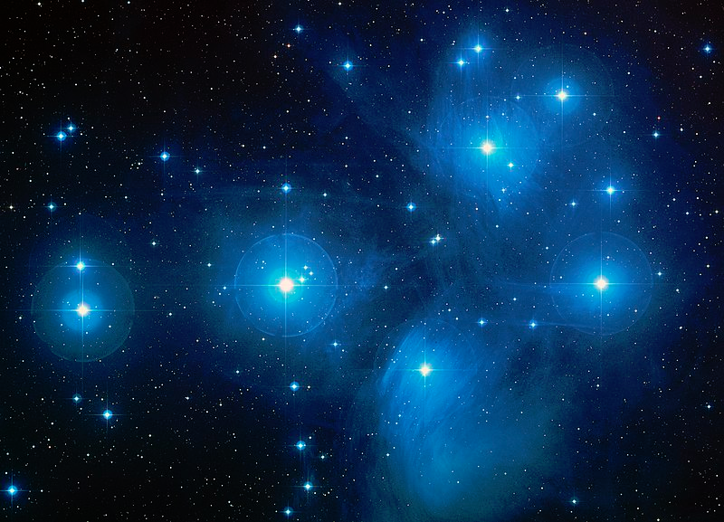

Slide 4
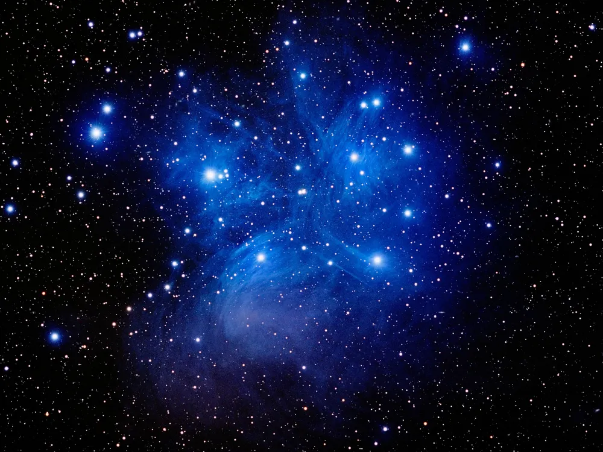
Pleiades – The 7 Sisters
M 45
An asterism and an open cluster about 444 light years away.
It is the closest Messier object to earth and the most obvious star cluster to the naked eye.
The nebulosity is not evident in our light polluted skies

Slide 6
Pearl Cluster
Rich Man’s Jewel Box
NCG 3766

Slide 7
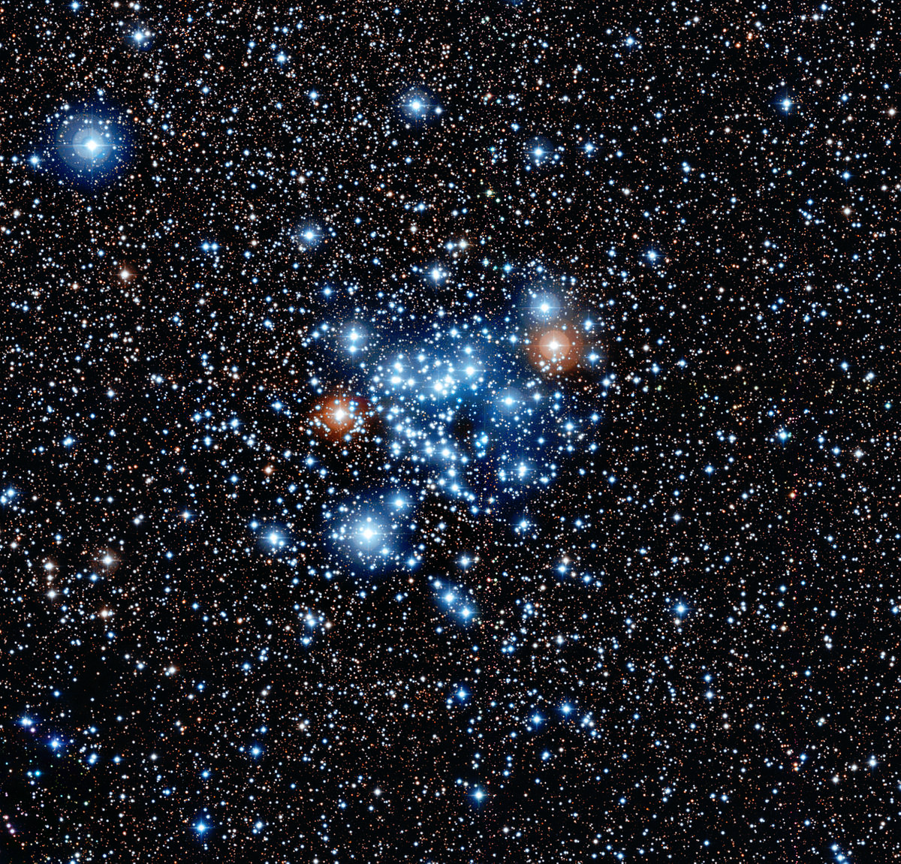

Slide 8
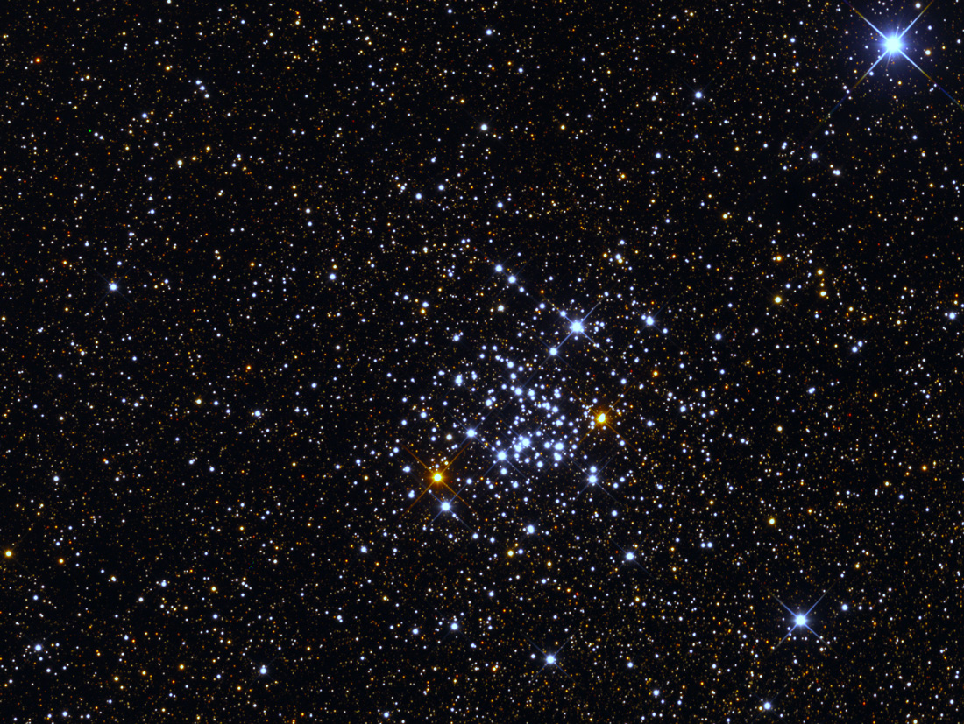
The Pearl Cluster
An open star cluster in the constellation Centaurus.
It contains 147 listed stars.
It is about 5500 light years away and about 14.4 million years old.
Now to be found directly above the Southern Cross.

Slide 10
Beta Monocerotis
A Triple Star System

Slide 11
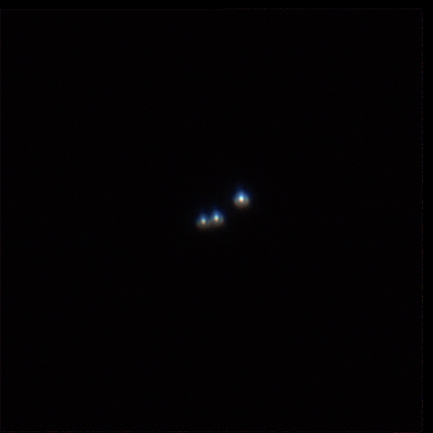

Slide 12
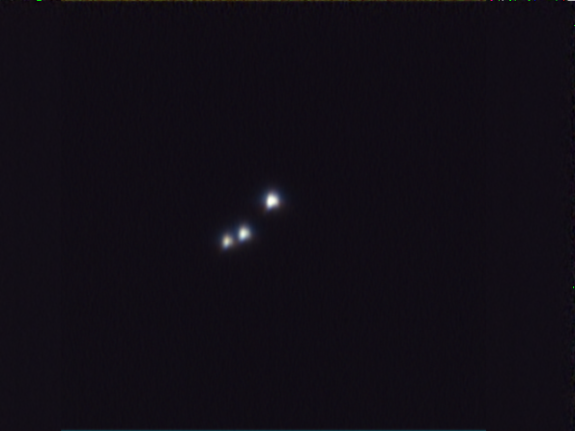
Beta Monocerotis
A triple star system in the constellation Monoceros -
A variable star seen as 3 stars in a straight line
William Herschel considered it “One of the most beautiful sights in the heavens.
Found about halfway down a line drawn from Sirius to Betelgeuse – visible as a star to the naked eye

Slide 14
Challenge:
The Tarantula Nebula
NGC 2070

Slide 15
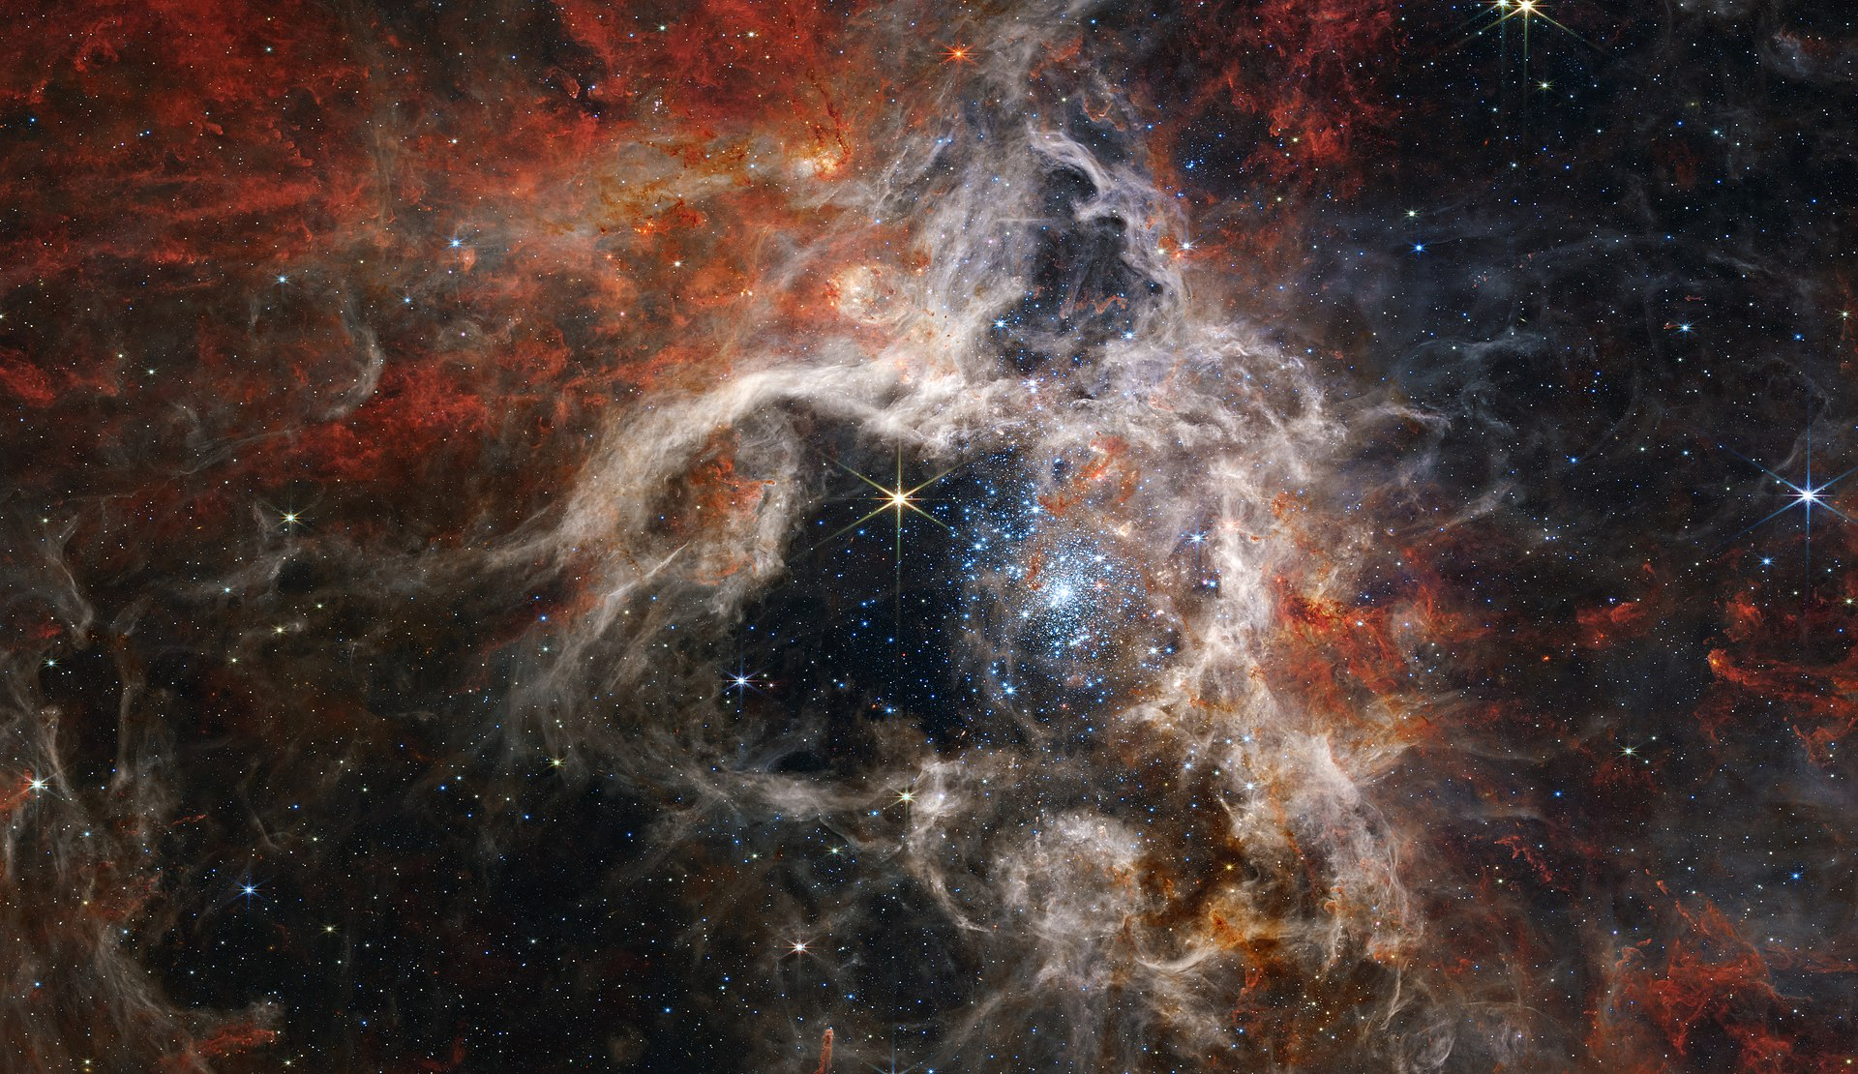
James Webb Photo

Slide 16
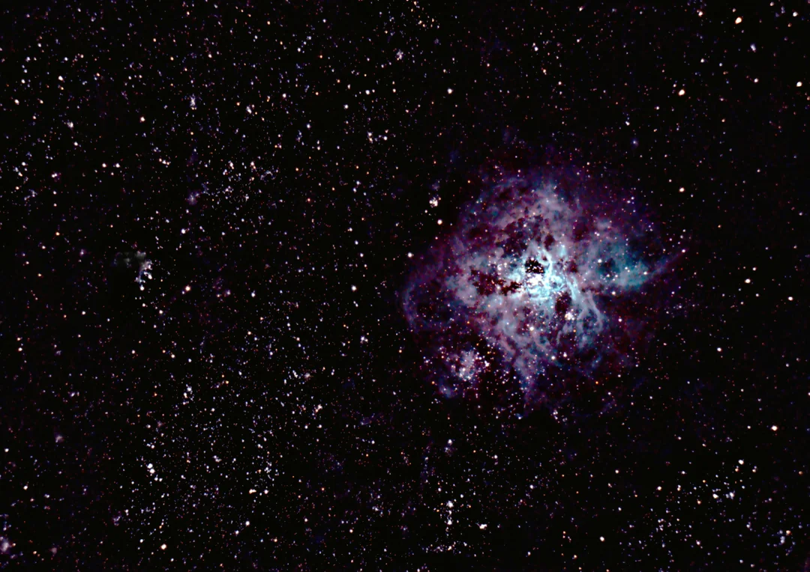
Tarantula Nebula -
Also known as 30 Doradus
About 160 000 light years away.
Now directly under Canopus and roughly level with Beta Carina.
It is faint under our light pollution but quite distinctly visible – doesn’t look like the James Webb photo!!!!

Slide 18


Thank You

