Slide 1

What’s Up??
January 2024
John Lindsay-Smith

Slide 2

47 Tuc
47 Tucanae
NGC 104

Slide 3
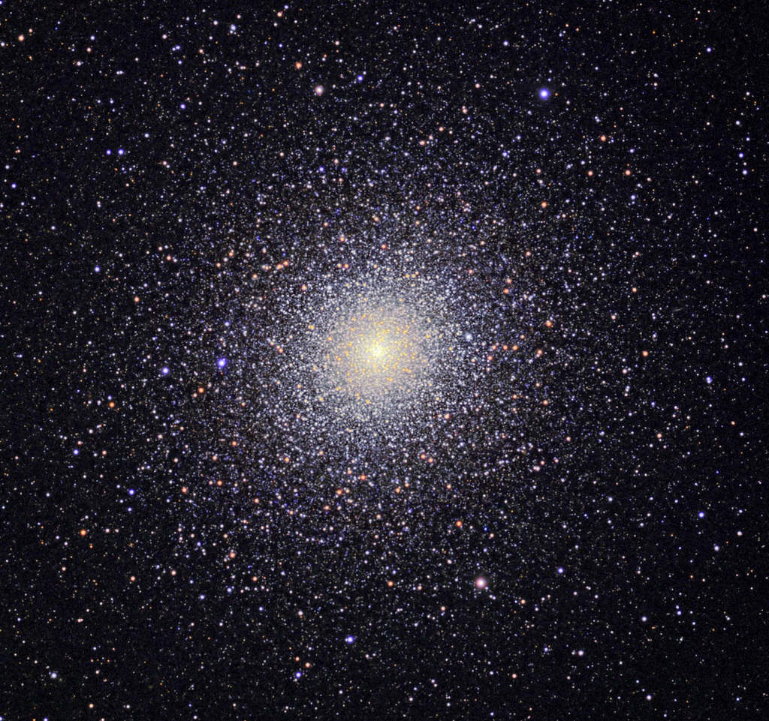

Slide 4
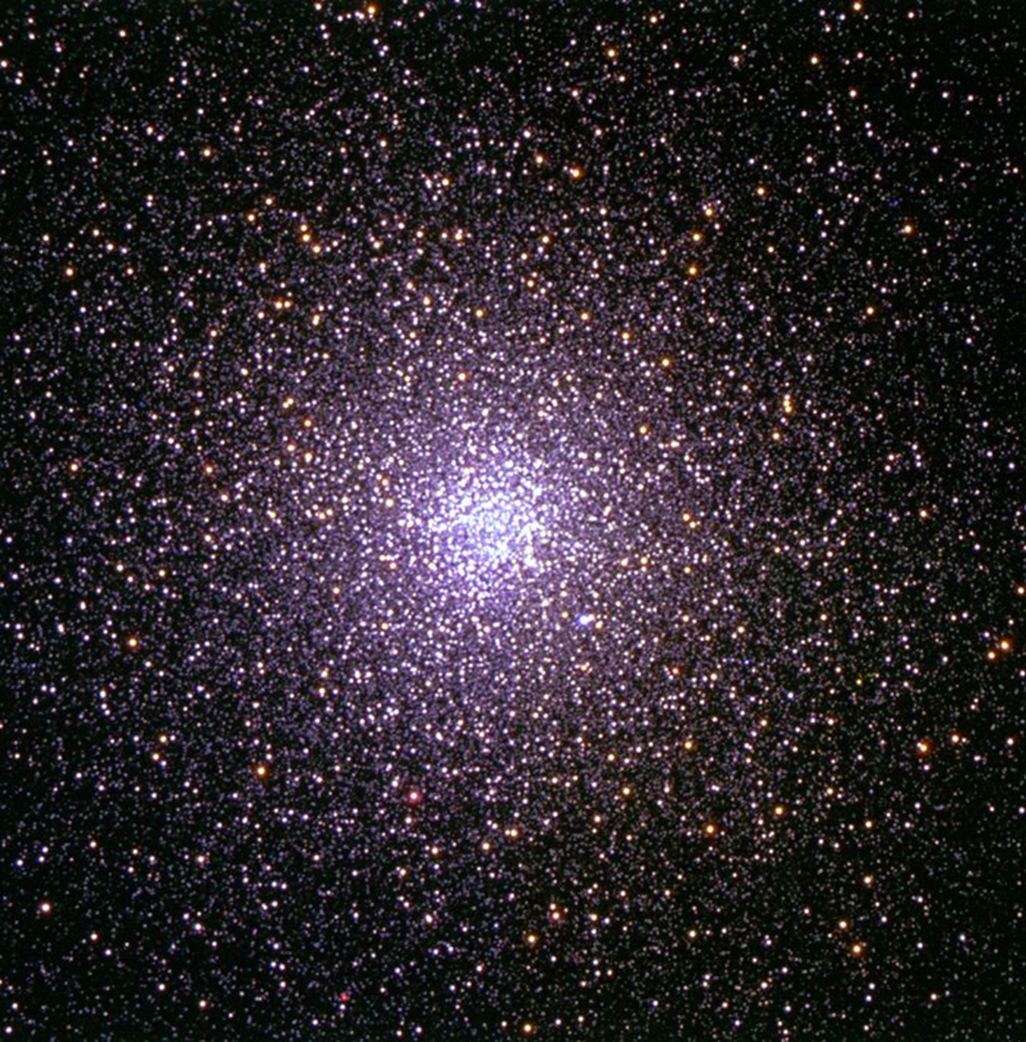
47 Tucanae
The second brightest globular cluster after Omega Centauri
Distance 13 050 light years
Has a small, very bright and dense core

Slide 6
Jupiter

Slide 7
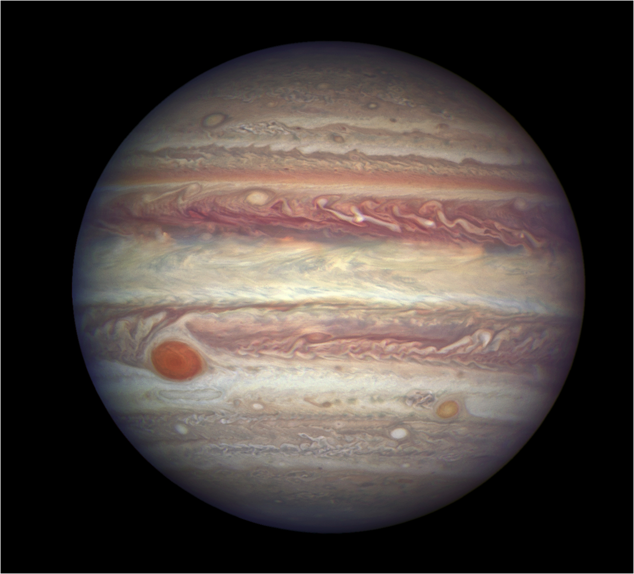
Jupiter
Unmistakeable, the brightest object in the sky at present
Rises high enough for decent viewing by about 20h00
Look for the 4 Galilean moons

Slide 8
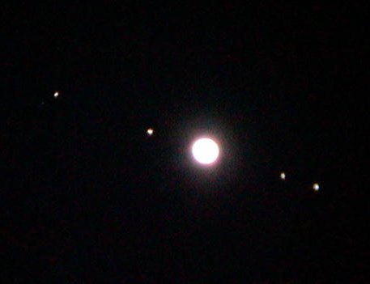

Slide 9
M 42 – the Great Nebula in Orion

Slide 10
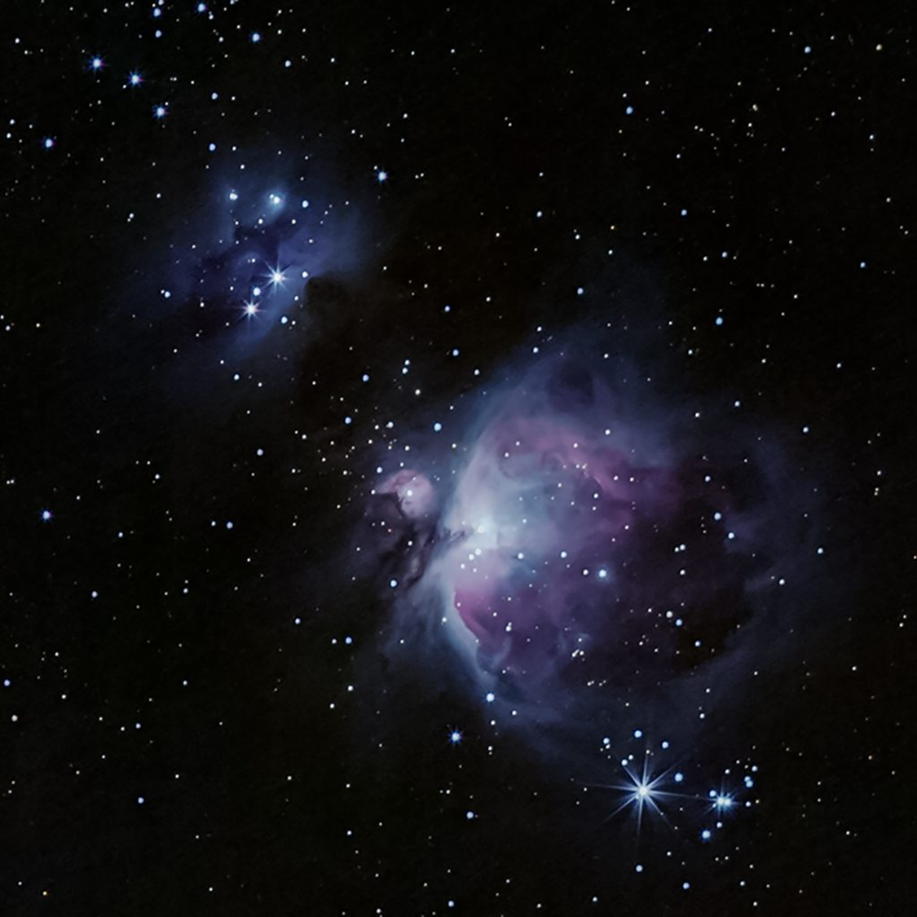

Slide 11
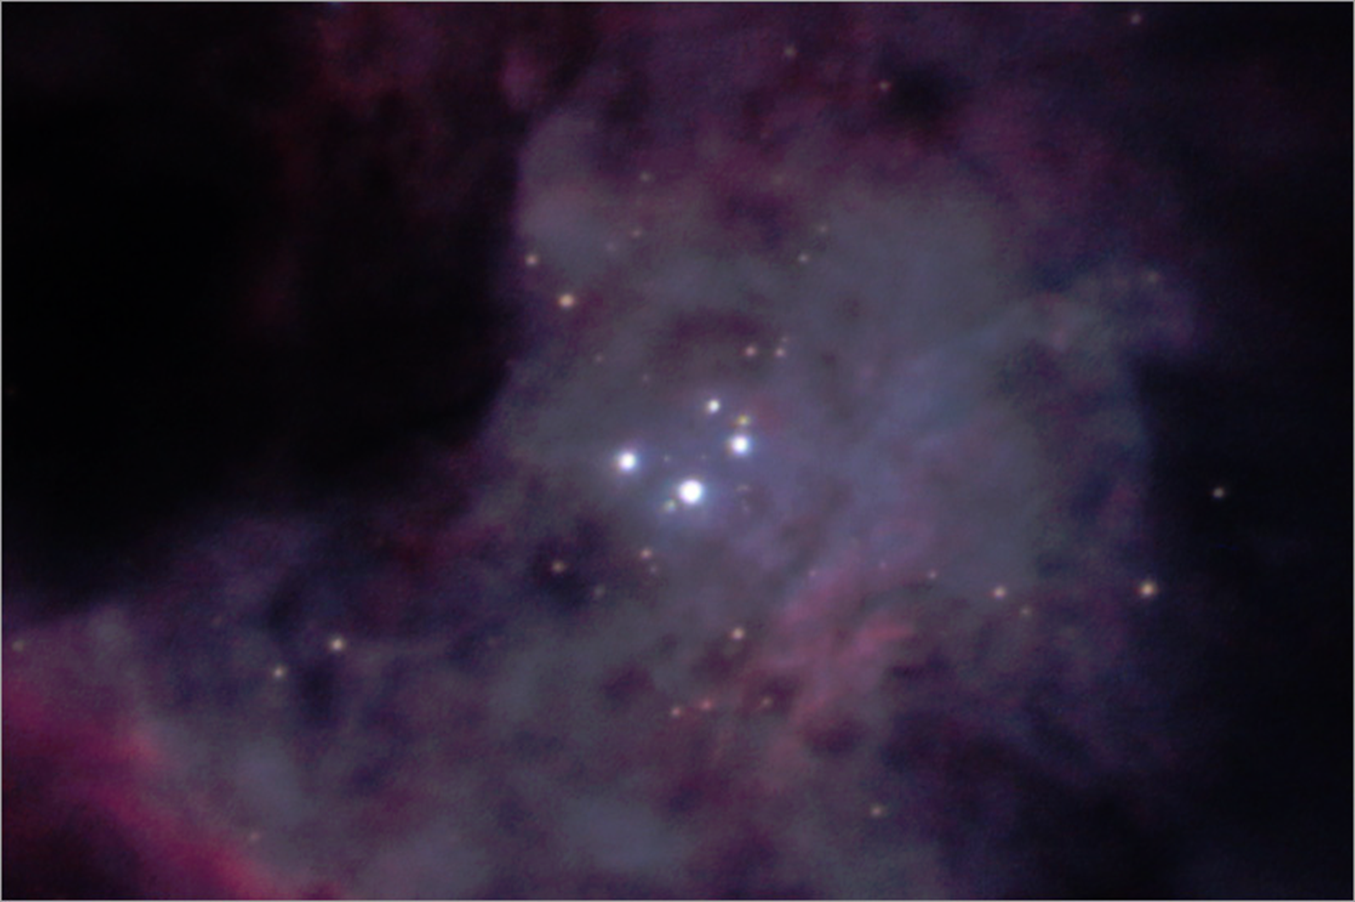
M42 – The Great Nebula in Orion
It is the closest region of massive star formation to earth – about 1350 light years away.
Contains a very young open cluster known as the trapezium – 4 easily visible stars with 2 binary components visible in good seeing.

Slide 13
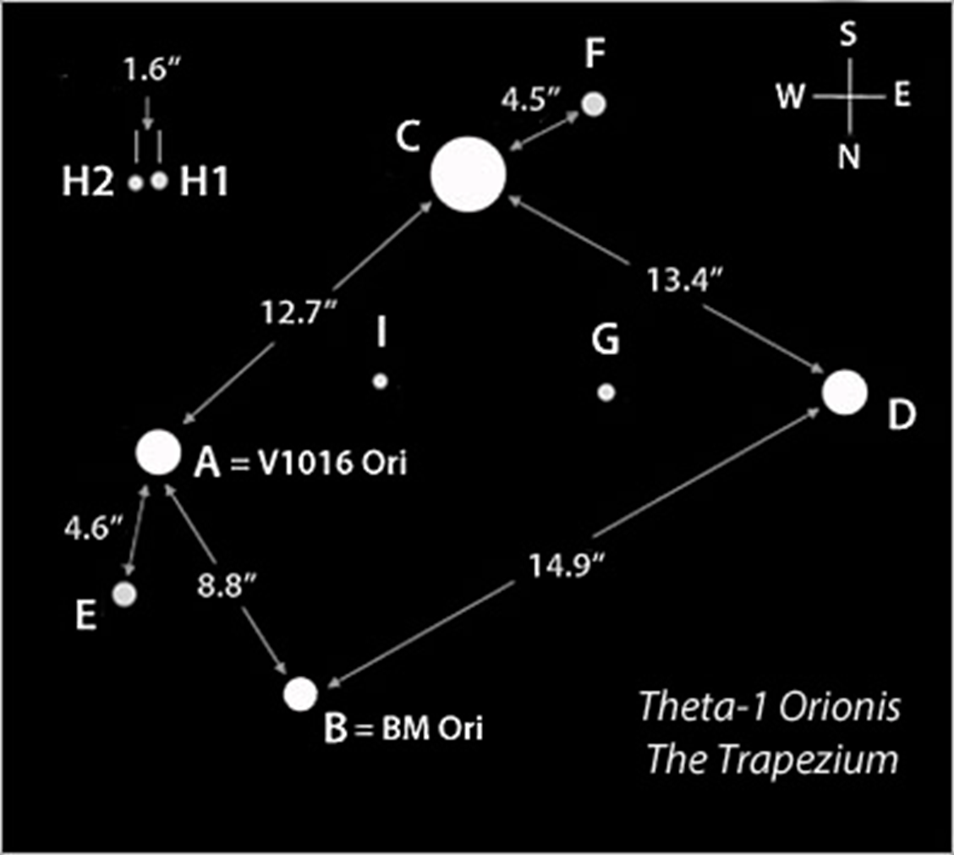

Slide 14


Thank You

